Slide 1
RANK Transformation

Slide 2
It returns the top few or bottom few records as per the condition

Slide 3
Enum | Ename | Department | DNum | Role | Sal
1 | Murali | Marketing | 10 | Manager | 30000
2 | Geeta | IT | 12 | Manager | 35000
3 | Anjali | Sales | 13 | Admin | 20000
4 | Alice | IT | 12 | Developer | 25000
5 | Bob | IT | 12 | Sr. Developer | 30000
6 | Rahul | Marketing | 10 | Helper | 30000
7 | Raj | IT | 12 | Librarian | 35000
8 | Sharon | Sales | 13 | Manager | 20000

Slide 4
2 | Geeta | IT | 12 | Manager | 35000
7 | Raj | IT | 12 | Librari | 35000
1 | Murali | Marketing | 10 | Manager | 30000

Slide 5
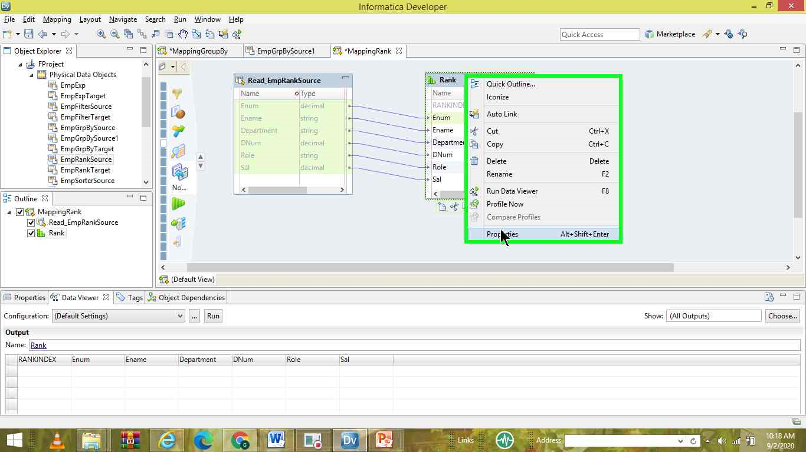

Slide 6
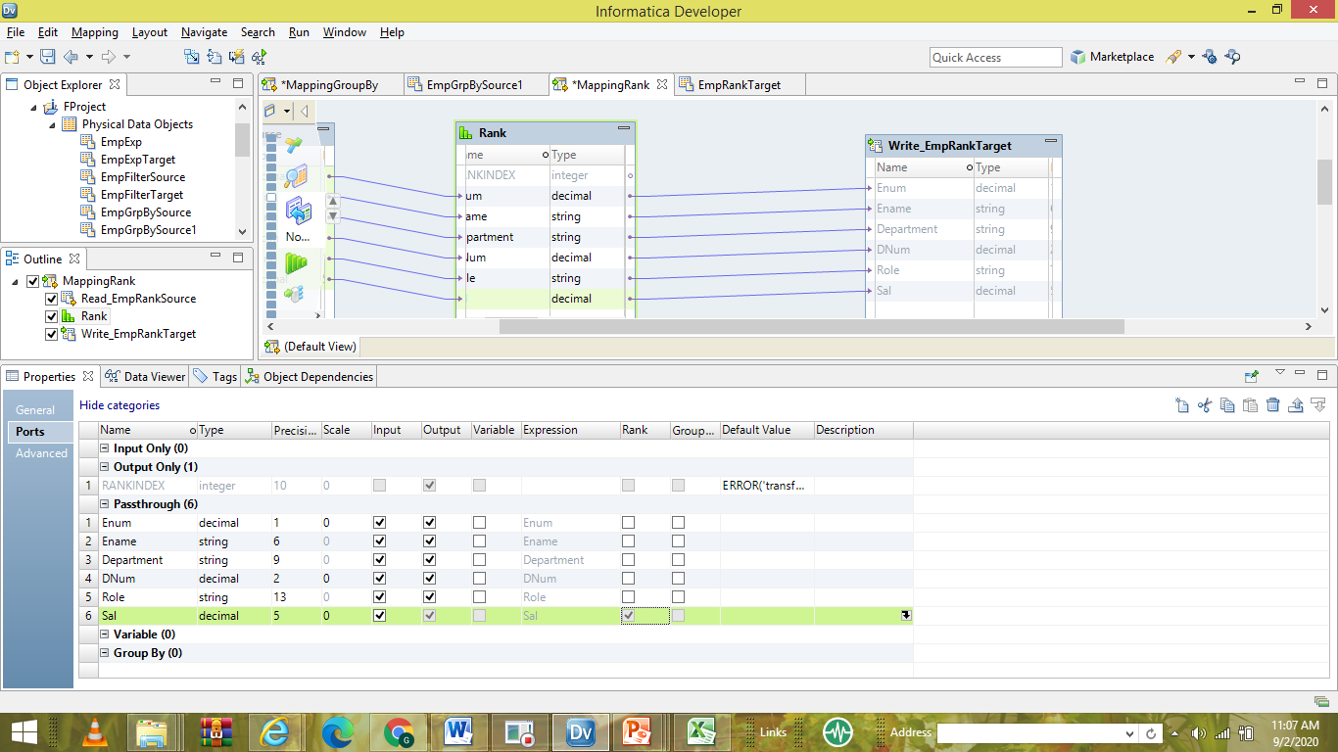

Slide 7
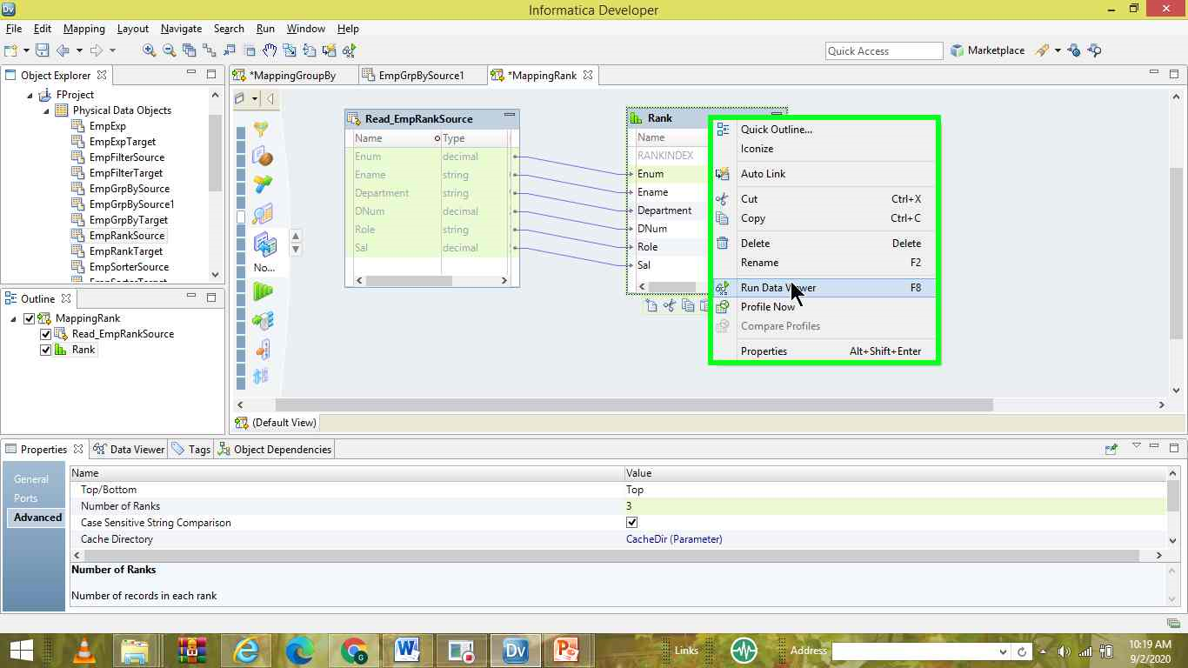

Slide 8
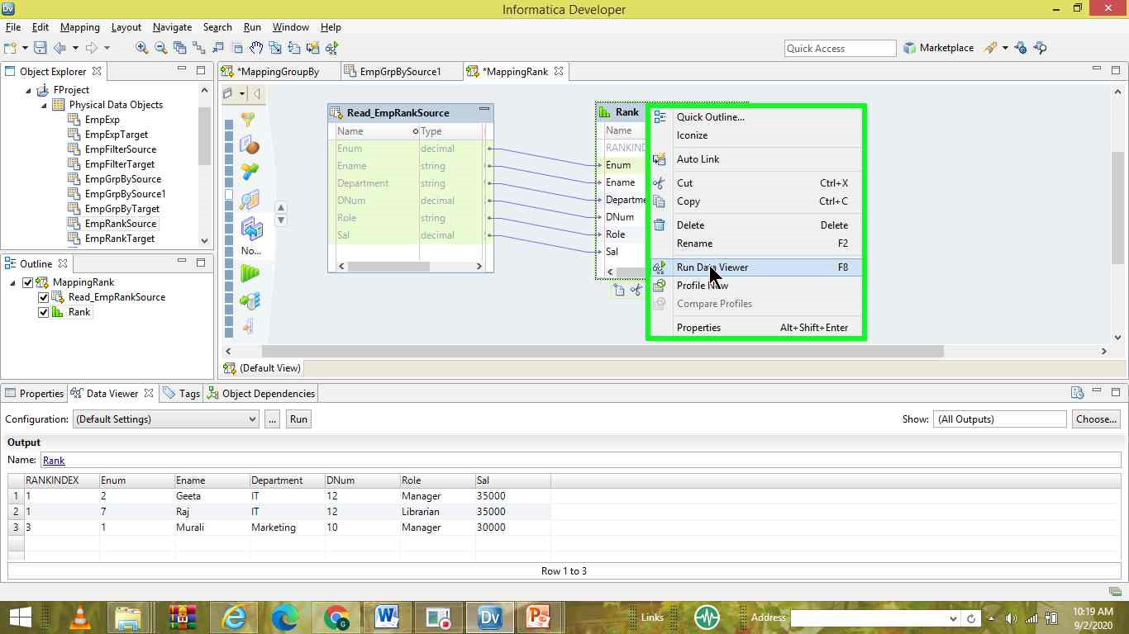

Slide 9
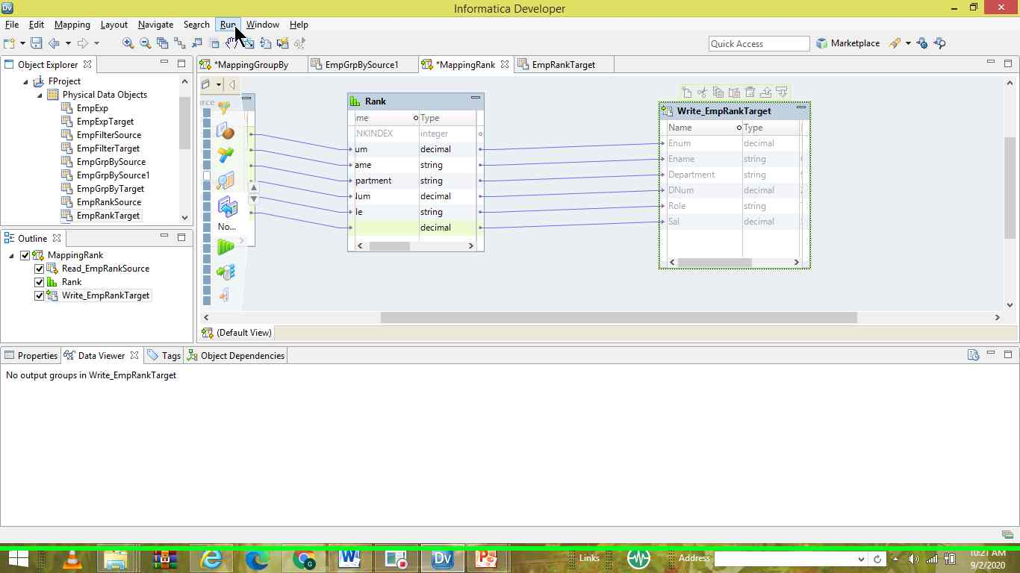

Slide 10
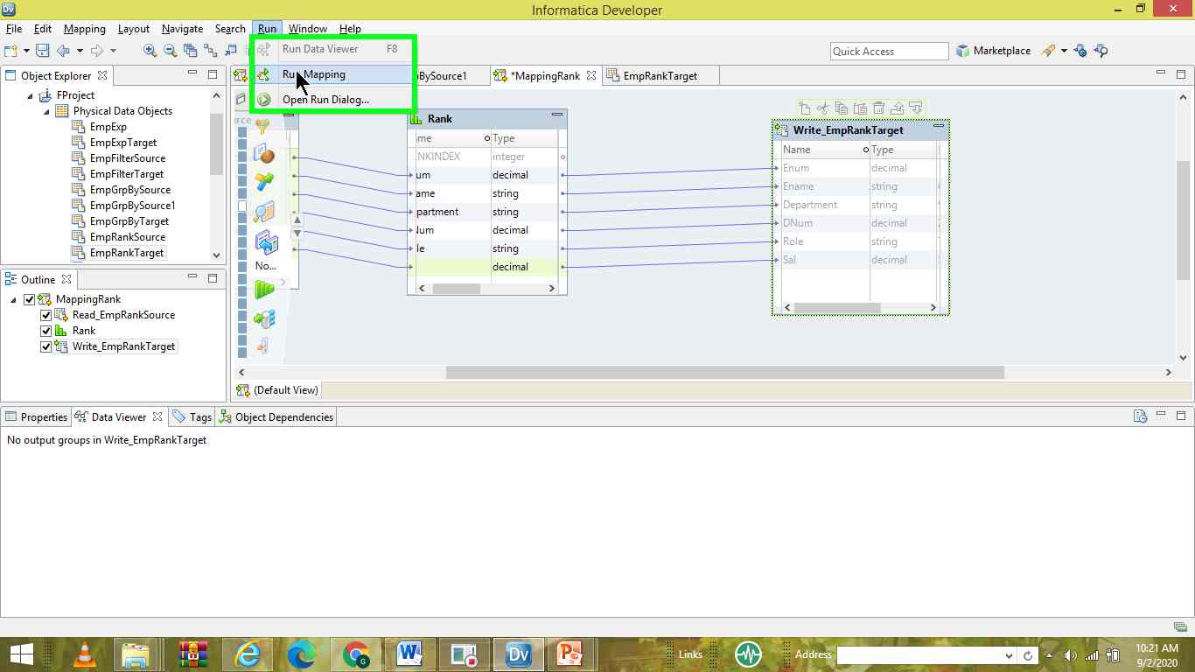

Slide 11
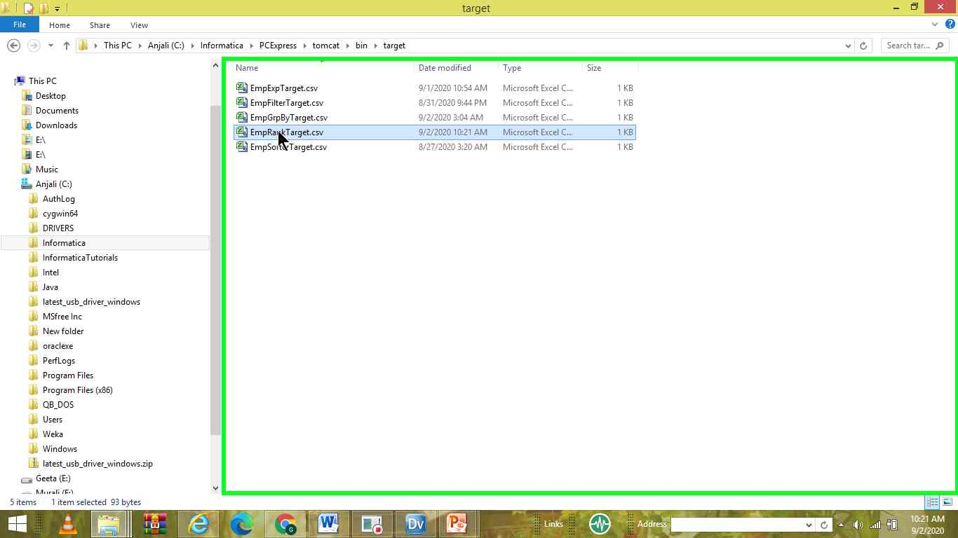

Slide 12
